Slide 1

Azure Management from any Platform using PowerShell One Codebase to Rule Them All
Jessica Deen
Technical Evangelist - Microsoft
www.jessicadeen.com | @jldeen Jessica.Deen@Microsoft.com

Slide 2




We’re Reimagining Microsoft
Our Mission
Our Strategy
Build the best-in-class platforms and productivity services for the mobile-first, cloud-first world
We will empower
every person and
every organization
on the planet
to achieve more
Our Ambitions
Reinvent productivity & business processes
Build the intelligent cloud platform
Create more personal computing
Notes:
[Script]:
Every great company has an enduring mission. We’ve challenged ourselves to think about our core mission, our soul – what would be lost if we disappeared.
We will empower every person and every organization on the planet to achieve more. We have unique capabilities in harmonizing the needs of both individuals and organizations. This is in our DNA. Perhaps “on the planet” is the most important and interesting idea in that statement. We care deeply about making a difference in lives and organizations in all corners of the planet.
Our strategy is to build best-in-class platforms and productivity services for a mobile-first, cloud-first world. Our platforms will harmonize the interests of end users, developers and IT better than any competing ecosystem or platform. We will realize our mission and strategy by investing in three interconnected and bold ambitions.
Again, doing so isn’t simply good business. It’s playing a part in the most fundamental of human activities: creating tools that enable each of us to continue our journey to become something more. In summary, we want to Empower you to achieve more!

Slide 3


GOING DIGITAL
1 million/hour
new devices coming online
by 2020
12 years
average age of S&P 500 corporations
by 2020
60% computing
in the public cloud by 2025
Notes:
Why is this transformation important? Let’s take a look at the next few years before us…
In 2020, 1 million new devices are expected to come online every hour. The connectivity between people and data is creating billions of new relationships that are driven not only by data but by algorithms that keep customers engaged and buying.*
In 2020, the average age of a S&P 500 corporation is expected to be 12 years old. Compare that to the S&P 500 in 1960 when the average age was 60 years old.**
By the year 2025, at least 60 percent of computing will be cloud-based, due to “everything-as-a-service” shifting fundamental changes in the IT industry.***
For digital transformation, mobility is the universal catalyst and cloud is the great enabler.
How are you planning for digital transformation? Do you have the right people and the right technology in place to build your digital vision?
How can you use technology to shape your future?
*http://www.gartner.com/newsroom/id/3142917
**http://upstart.bizjournals.com/resources/author/2015/06/04/fortune-500-must-disrupt-or-die-writes-r-ray-wang.html?page=all
***http://www.emersonnetworkpower.com/en-US/Latest-Thinking/Data-Center-2025/Documents/002401_DataCenter2025Report_HR_INTERACTIVE.PDF

Slide 4
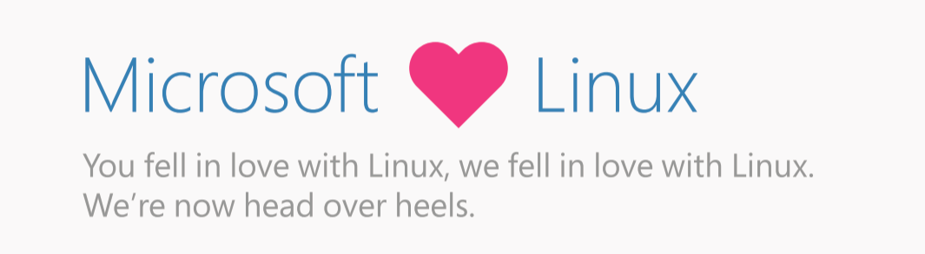
Notes:
Why is this transformation important? Let’s take a look at the next few years before us…
In 2020, 1 million new devices are expected to come online every hour. The connectivity between people and data is creating billions of new relationships that are driven not only by data but by algorithms that keep customers engaged and buying.*
In 2020, the average age of a S&P 500 corporation is expected to be 12 years old. Compare that to the S&P 500 in 1960 when the average age was 60 years old.**
By the year 2025, at least 60 percent of computing will be cloud-based, due to “everything-as-a-service” shifting fundamental changes in the IT industry.***
For digital transformation, mobility is the universal catalyst and cloud is the great enabler.
How are you planning for digital transformation? Do you have the right people and the right technology in place to build your digital vision?
How can you use technology to shape your future?
*http://www.gartner.com/newsroom/id/3142917
**http://upstart.bizjournals.com/resources/author/2015/06/04/fortune-500-must-disrupt-or-die-writes-r-ray-wang.html?page=all
***http://www.emersonnetworkpower.com/en-US/Latest-Thinking/Data-Center-2025/Documents/002401_DataCenter2025Report_HR_INTERACTIVE.PDF

Slide 5


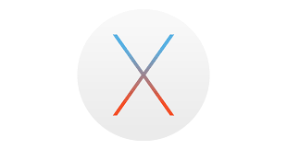
PowerShell Core and Bash on Windows 10
PowerShell
Linux and OS X
Heterogeneous world
Use any client
Run workloads on any server
And any cloud
Linux
OS X
Notes:
Open source
GitHub
MIT License
Open to community development
Contributors
Committers
Refactored on .NET Core
One code base for all OSes

Slide 6
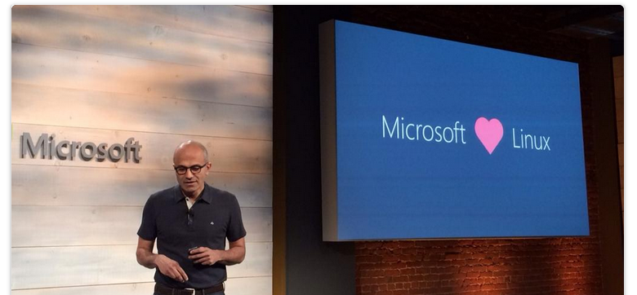
“This is not your Dad’s Microsoft.”

Slide 7






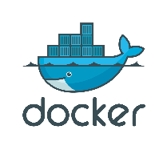
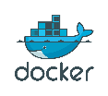




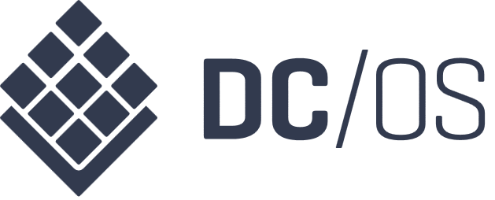

Our Approach to Open Source in the Cloud
Enable
Integrate
Release
Participate
Enable Linux and Open Source technology to be first class citizens on Microsoft Platforms
Embrace leading Open Source ecosystems and integrate Microsoft products with agility and consistency
Release key Microsoft technologies into the Open Source domain to build a strong ecosystem
Microsoft engineers to participate in communities and contribute to key Open Source projects
R Server
.NET Core
Roslyn
TypeScript
F#
autorest
PowerBI Visuals
Office UI Fabric
Tools plugins
Open Source Partners & Ecosystem
Notes:
Notes coming soon – please check back on http://aka.ms/opensource for latest version

Slide 8
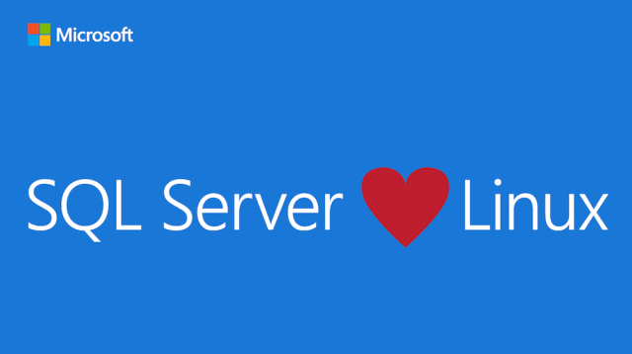

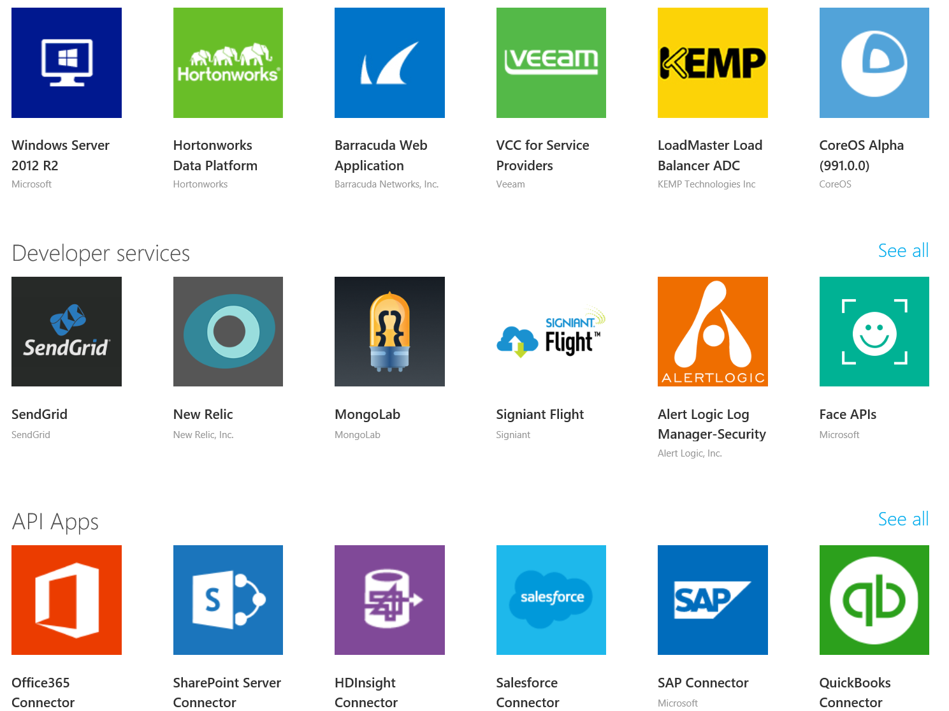
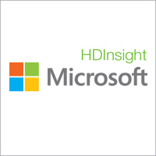

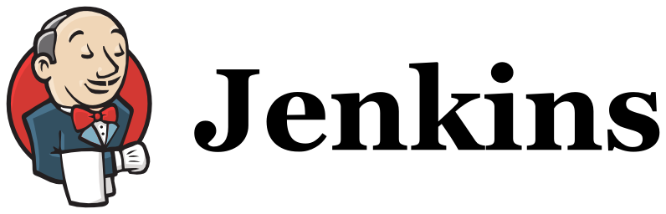


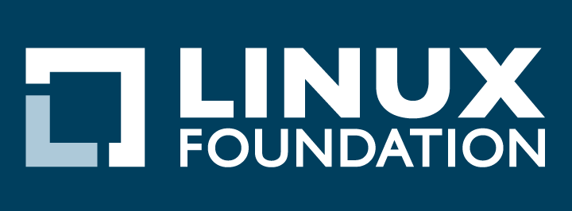

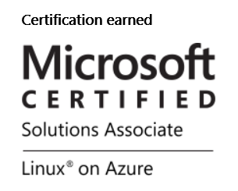
Open Source Investments are Fueling the Momentum
Our Products
Our Offerings
Azure Marketplace
60% of all images in Azure Marketplace are based on Linux/OSS
SQL Server on Linux
Acquisition
Windows Subsystem for Linux
1 out of 3 VMs on Azure run Linux, and more than half of all new VMs run Linux
C:\Users\markhill> bash
1 out of 3
HD Insight managed service on Linux
root@localhost: #
Run Linux on Windows natively
Our Partnerships
Our Employees
Ross Gardler President Apache SW Foundation
Wim Coekaerts Oracle’s Mr. Linux joins Microsoft
Partnership
Jenkins project on Azure
Partnership with the Linux Foundation for Linux on Azure certification
600 Million+
Lines of open source code submitted to GitHub by Microsoft engineers
Microsoft joins Eclipse Foundation
Microsoft Open Source Hub
Notes:
Notes coming soon – please check back on http://aka.ms/opensource for latest version

Slide 9
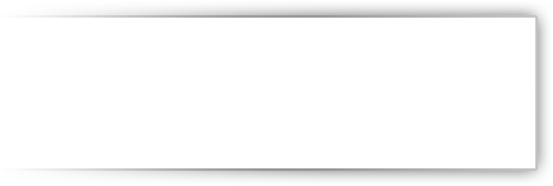





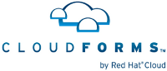

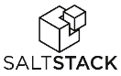


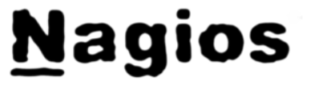


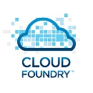



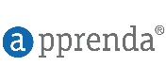






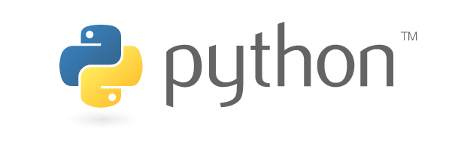
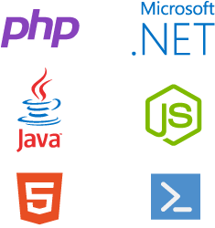

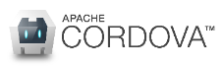





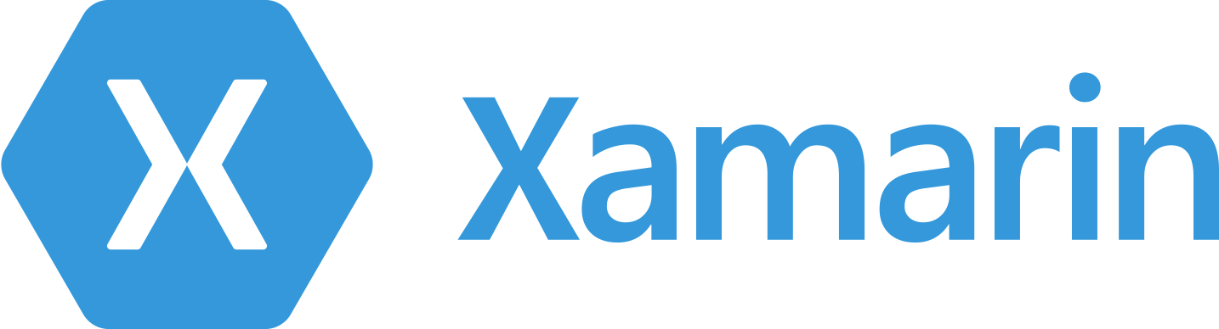
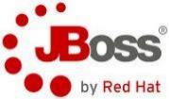



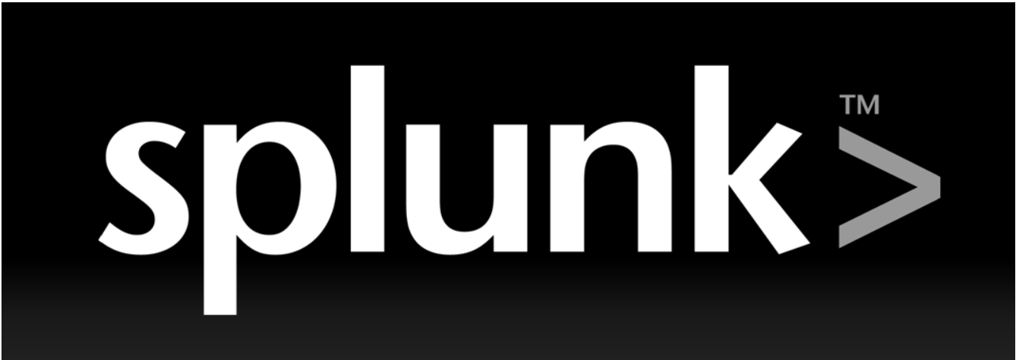





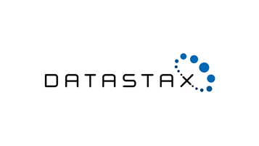



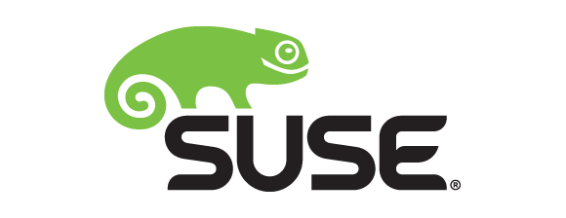

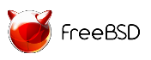




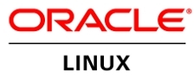
Azure: Delivering Open Source Innovation in the Cloud
Addressing Your Enterprise Cloud Needs in a Trustworthy Way
Private Cloud
Hybrid Cloud
Public Cloud
Trust In Microsoft
..... Now Across Your Entire Stack!
Management
System Center
OMS
DevOps & PaaS
Team Foundation Services
Applications
Dynamics
SharePoint
Exchange
Frameworks & Tools
.NET
Visual Studio
Data
SQL Server
Infrastructure
Windows
Server
Notes:
Notes coming soon – please check back on http://aka.ms/opensource for latest version

Slide 10
Windows Server: The story so far…
SCALE
64 vCPU per VM
1TB RAM per VM
4TB RAM per host
320 LP per host
64 TB VHDX
1024 VMs per host
vNUMA
AGILITY
Dynamic memory
Live migration
LM with compression
LM over SMB direct
Storage LM
Shared nothing LM
Cross-version LM
Hot add/resize VHDX
Storage QoS
Live VM export
AVAILABILITY
Host clustering
64 node clusters
Guest clustering
Shared VHDX
Hyper-V replica
Built in.
NETWORKING
Integrated network virtual
Network virtual gateway
Extended port ACLs
vRSS
Dynamic teaming
AND MORE…
Gen 2 VMs
Enhanced session
Auto VM activation
HETEROGENEOUS
Linux
FreeBSD

Slide 11
Server 2016 Features
Failover Clustering
VM Compute Resiliency - provides resiliency to transient failures such as a temporary network outage, or a non-responding node
VM Storage Resiliency - Preserves tenant virtual machine session state in the event of transient storage disruption; VM moved to PausedCritical state.
Node Quarantine - Unhealthy nodes are quarantined and are no longer allowed to join the cluster; VMs are live migrated from the cluster node.
Virtual Machine Upgrades
Improved with compatibility mode and a serving model
PowerShell Direct
Memory Management
New Runtime Resize - Administrators can now increase or decrease VM memory without VM downtime
Windows Server 2012 R2 Hyper-V
v6
v6
v6
v6
Windows Server Technical Preview Hyper-V

Slide 12
Failover Clustering Integrated solution, enhanced in Windows Server Technical Preview
VM compute resiliency
Provides resiliency to transient failures such as a temporary network outage, or a non-responding node
In the event of node isolation, VMs will continue to run, even if a node falls out of cluster membership
This is configurable based on your requirements—default set to 4 minutes
VM storage resiliency
Preserves tenant virtual machine session state in the event of transient storage disruption
VM stack is quickly and intelligently notified on failure of the underlying block or file-based storage infrastructure
VM is quickly moved to a PausedCritical state
VM waits for storage to recover and session state retained on recovery
Hyper-V cluster
Shared storage

Slide 13

Failover clustering Integrated solution, enhanced in Windows Server Technical Preview
Node quarantine
Unhealthy nodes are quarantined and are no longer allowed to join the cluster
This capability prevents unhealthy nodes from negatively affecting other nodes and the overall cluster
Node is quarantined if it unexpectedly leaves the cluster three times within an hour
Once a node is placed in quarantine, VMs are live migrated from the cluster node, without downtime to the VM
Hyper-V cluster
Shared storage

Slide 14
Virtual machine upgrades New virtual machine upgrade and servicing processes
Compatibility mode
When a VM is migrated to a Windows Server Technical Preview host, it will remain in Windows Server 2012 R2 compatibility mode
Upgrading a VM is separate from upgrading host
VMs can be moved back to earlier versions until they have been manually upgraded
Update-VMVersion vmname
Once upgraded, VMs can take advantage of new features of the underlying Hyper-V host
Servicing model
VM drivers (integration services) updated as necessary
Updated VM drivers will be pushed directly to guest operating system via Windows Update
By running Update-VMVersion, VM will be upgraded to newest hardware version and can use the new Hyper-V features
Windows Server Technical Preview supports previous version VMs in compatibility mode
v6
v6
v6
v6
Windows Server 2012 R2 Hyper-V
Windows Server Technical Preview Hyper-V

Slide 15
PowerShell Direct
Bridge the boundary between Hyper-V host and guest VM in a secure way to issue PS cmdlets and run scripts easily
Currently supports Windows 10/Windows Server 2016 guest on Windows 1 10/Windows Server 2016 host
No need to configure PS remoting or network connectivity
Just need the guest credentials
Can only connect to particular guest from that host
Enter-PSSession -VMName VMName
Invoke-Command -VMName VMName -ScriptBlock { Fancy Script }

Slide 16
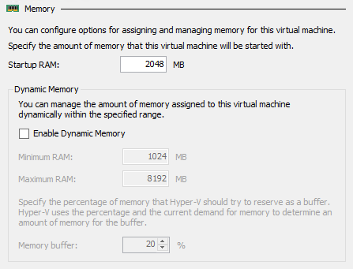
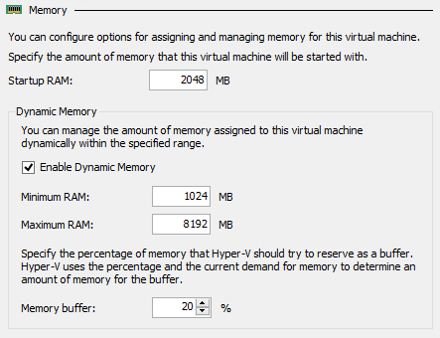
Memory management Complete flexibility for optimal host utilization
Static memory
Startup RAM represents memory that will be allocated regardless of VM memory demand
*NEW* Runtime resize
Administrators can now increase or decrease VM memory without VM downtime
Cannot be decreased lower than current demand, or increased higher than physical system memory
Dynamic memory
Enables automatic reallocation of memory between running VMs
Results in increased utilization of resources, improved consolidation ratios and reliability for restart operations
Runtime resize
With Dynamic Memory enabled, administrators can increase the maximum or decrease the minimum memory without VM downtime

Slide 17
And much more…
AVAILABILITY
VM Compute Resiliency
VM Storage Resiliency
Node Quarantine
Shared VHDX – Resize, Backup, Replica Support
Memory – Runtime Resize for Static/Dynamic
vNIC – Hot-Add and vNIC Naming
OPERATIONAL EFFICIENCIES
Production Checkpoints
PowerShell Direct
Hyper-V Manager Improvements
ReFS Accelerated VHDX Operations
ROLLING UPGRADES
Upgrade WS2012R2 -> WS2016 with no downtime for workloads (VMs / SOFS) or additional H/W
VM Integration Services from Windows Update

Slide 18
Introducing Nano Server

Slide 19
The story so far…
Roles and features
GUI shell
Full server
Minimal server interface
Windows/ Windows NT
Server Core
Server Core
Windows NT to Windows Server 2003
Windows Server 2008 and Windows Server 2008 R2
Windows Server 2012 and Windows Server 2012 R2

Slide 20

“ I want just the components
I need, and nothing more.”

Slide 21
“We need server configuration
optimized for the cloud.”

Slide 22
The next step in the journey…
Nano Server: A new headless, 64-bit only, deployment option for Windows Server
Server with a desktop experience
Deep refactoring with cloud emphasis
Cloud fabric & infrastructure (clustering, storage, networking)
Born-in-the-cloud applications (PaaS v2, ASP.NET v5)
VMs & Containers (Hyper-V & Docker)
Server Core
Extend the Server Core pattern
Roles & features live outside of Nano Server
No binaries or metadata in OS image
Standalone packages install like apps
Full driver support
Antimalware
Nano Server

Slide 23
Nano Server
Nano Server is an Installation Option
Located on the Windows Server media
Must be customized to determine it’s functionality
Zero-footprint model
Server roles and optional features live outside of Nano Server
Standalone packages that install like applications, from local/cloud repositories
Key roles and features
Hyper-V, Storage (SoFS), Networking (DNS), Clustering
Core CLR, ASP.NET 5 and PaaS
Full Windows Server driver support
Antimalware available as optional feature

Slide 24
Servicing improvements*
Important bulletins
Critical bulletins
Reboots required
* Analysis based on all patches released in 2014

Slide 25
Deployment improvements
Setup time (Sec)
Disk footprint (GB)
VHD size (GB)

Slide 26
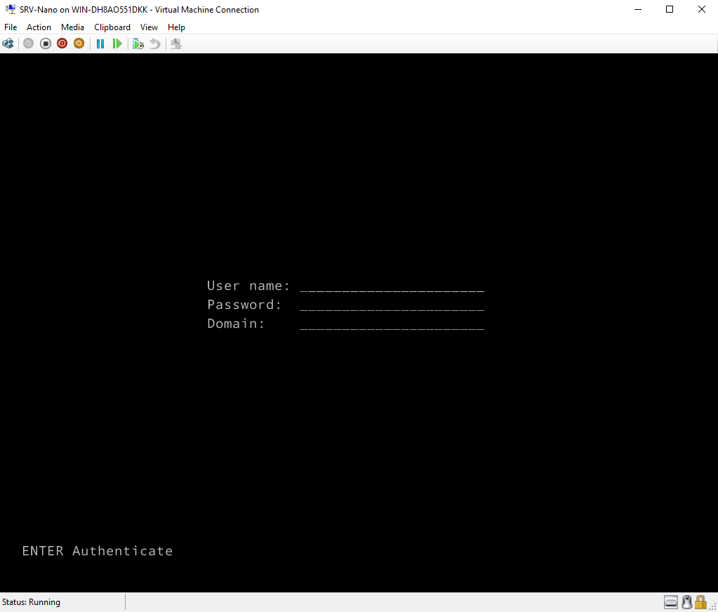
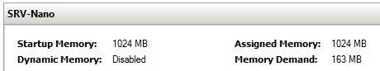
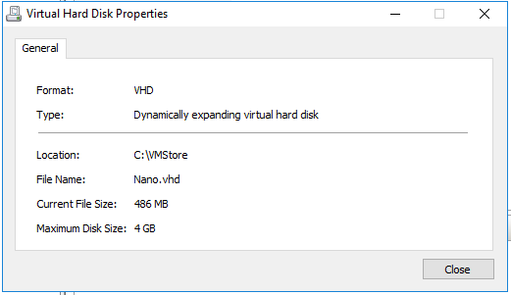
The end result…

Slide 27
Nano Server roles and features
Table shows roles and features that are available in this release of Nano Server, along with the Windows PowerShell options that will install the packages for them
Role or feature | Option
Hyper-V role | -Compute
Failover clustering | -Clustering
File server role and other storage components | -Storage
Windows Defender antimalware, including a default signature file | -Defender
OEM drivers—select drivers that ship in-box with Server Core | -OEMDrivers
Reverse forwarders for application compatibility, for example common application frameworks such as Ruby, Node.js, etc. | -ReverseForwarders
Hyper-V guest drivers for hosting Nano Server as a VM | -GuestDrivers
Host Support for Windows Containers | -Containers

Slide 28
Nano Server roles and features
Table shows roles and features that are available in this release of Nano Server, along with the Windows PowerShell options that will install the packages for them
Role or feature | Option
DNS Server Role | -Packages Microsoft-NanoServer-DNS-Package
Desired State Configuration (DSC) | -Packages Microsoft-NanoServer-DSC-Package
IIS Web Server | -Packages Microsoft-NanoServer-IIS-Package
System Center VMM Agent | -Packages Microsoft-Windows-Server-SCVMM-Package -Packages Microsoft-Windows-Server-SCVMM-Compute-Package
Network Perf Diagnostics Service (NPDS) | -Packages Microsoft-NanoServer-NPDS-Package
Data Center Bridging | -Packages Microsoft-NanoServer-DCB-Package

Slide 29
Remotely managing Nano Server
Remote graphical & Web tools
PowerShell remoting
VM & container management
Deployment & monitoring
Partners & frameworks
Server manager
Azure Portal tools
Task manager
Registry editor
File explorer
Server configuration
Event viewer
Disk manager
Device & driver management
Performance
Users & groups
Core PowerShell engine, language, and cmdlets
Windows Server cmdlets (network, storage, etc.)
PowerShell DSC
Remote file transfer
Remote script authoring & debugging
PowerShell Web access
Hyper-V manager
Hyper-V cmdlets
PowerShell Direct over PSRP
CimSession support
Docker
SCVMM agent & console
3rd-party agents & consoles
DISM online & VHD support
Unattended setup
Visual Studio integration
DSC Local Config Manager
Setup & boot eventing
SCOM agent
VSO App Insights
Azure Op Insights
Chef integration
.NET Core and CoreCLR
ASP.NET 5
Python, PHP, Ruby, Node.js
PowerShell Classes
PS Script Analyzer
PowerShell Gallery
PowerShellGet

Slide 30
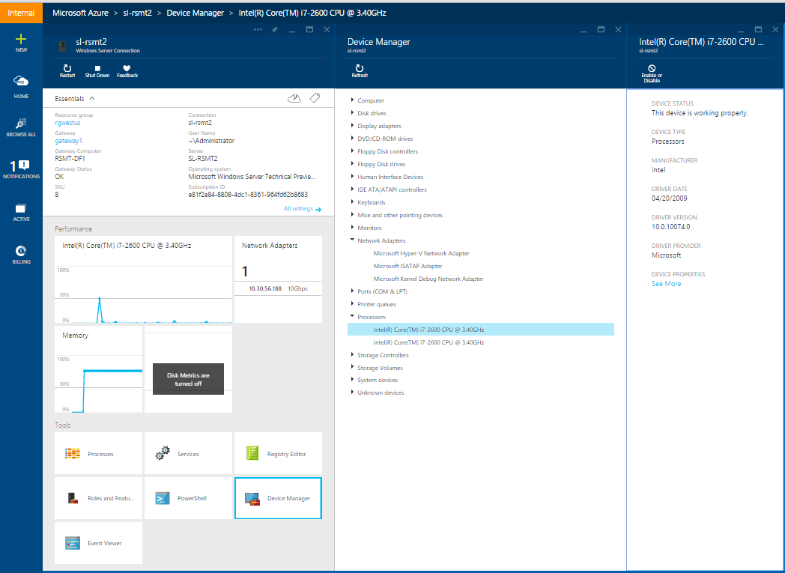
Remote Server Management Tool
Eliminating the need to ever sit in front of a server
Azure-based
Includes replacements for local-only tools
Task manager, registry editor
Event viewer, device manager
Sconfig
Control panel, file explorer
Performance monitor, disk management
Users/Groups manager
Supports Server Core and server with desktop experience

Slide 31






DevOps: the three stage conversation
DEV
OPS
1
People
2
Process
3
Products
Notes:
People = Culture
Fundamental attributes of successful cultures:
Shared mission and incentives: infrastructure as code, apps as services, DevOps/all as teams
You need to consider your hardware as a commodity, (don't give your servers names) , servers are like farm animals, it is just harder if you let theids name them
Build deep instrumentation into services, push complexity up the stack
Rally around agile, shared metrics, CI, service owners on call, etc.
Changing the culture: any change takes time, changing culture is no exception and you can't do it alone, exploit compelling events to change culture: downtimes, cloud adoption, devops buzz
PROCESS Definition and design, compliance, and continuous improvement
PEOPLE Responsibilities, management, skills development, and discipline
Products Tools and infrastructure

Slide 32
DevOps
1
4
Plan
Monitor + Learn
Development
Production
2
3
Develop + Test
Release

Slide 33
List of DevOps Practices
Infrastructure as Code (IaC)
Continuous Integration
Automated Testing
Continuous Deployment
Release Management
App Performance Monitoring
Load Testing & Auto-Scale
Availability Monitoring
Change/Configuration Management
Feature Flags
Automated Environment De-Provisioning
Self Service Environments
Automated Recovery (Rollback & Roll-Forward)
Hypothesis Driven Development
Testing in Production
Fault Injection
Usage Monitoring/User Telemetry
http://www.itproguy.com/devops-practices/

Slide 34
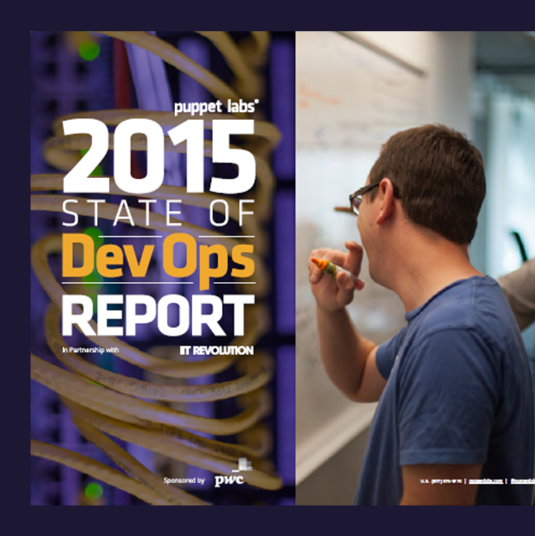
DevOps Benefits
Strong IT Performance is a competitive advantage
Deploy code 30x faster
Firms with high-performing IT organizations were 2x as likely to exceed their profitability, market share, and productivity goals
and with 200x shorter lead time as compared to their lower-performing peers
Have 60x fewer failures
DevOps Practices improve IT performance
and recover from failure 168x faster as compared to their lower-performing peers
Source: https://puppetlabs.com/
Notes:
2014 Report collected in December 2013 had over 9,200 survey respondents across 110 countries with companies of ALL sizes and verticals.
2015 Report had 4,976 respondents with companies of ALL sizes and verticals.

Slide 35
Architecture Decisions
Azure VMs (IaaS)
Containers
Azure Cloud Services
(PaaS)
Azure Websites (PaaS)
Most control, but most management overhead
Most cost
Puppet/Chef/DSC agent integration
Easier to port workloads from on-premises
Easiest portability from on-premises
Ecosystem of apps
Host OS abstracted, but still requires management
Startup tasks
More complex workloads
Do more than websites
APM compatible
Easy CI and CD setup
Easy Auto Recovery
Easy Testing in Prod
Easy deployments and scale
Efficient Cost
Only websites

Slide 36
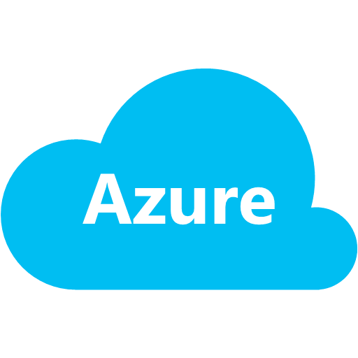


Microsoft Building Blocks for DevOps
Azure services
Visual Studio Online
People
Business
IT Operations
Developers/Testers
CLOUD
Websites
Cloud services
SQL database
StorSimple
API management
Multifactor
authorization
Build & continuous integration
Azure deploy & continuous deployment
Microsoft products
HYBRID
Process
Plan
Monitor & learn
Build & continuous integration
Azure deploy & continuous deployment
Load testing
Virtual machines
Virtual network
Active directory
Application insights
Load testing
Release management
Lab management
Collaborate
ON-PREMISES
Team foundation server
Test professional
Develop & test
Release
Notes:
[Slide goal]
Highlight the fact that Microsoft owns the entire ecosystem and therefore it can provide deeper integration across the platform and tooling, while still allowing for third party extension and augmentation when and where desired
[Talk track]
Microsoft is in a unique position to support an organization’s adoption of DevOps practices – Microsoft provides collaboration solutions, development tools, testing tools, release management tools, monitoring tools and services, as well as an infrastructure platform – both on-premises and in the cloud. There is no competitor that can match this breadth of solutions, tools, services and infrastructure offerings.
By owning all components of the DevOps ecosystem Microsoft can provide better integration between the tools and the platform and between the tools themselves, allowing organizations to spend less time configuring and managing tools and more time focusing on delivering value. By keeping the tools flexible and open, Microsoft still allows organizations to leverage existing investments in other tools.
Microsoft continues to invest in all areas of this ecosystem, which is a key asset to its own engineering organizations too. This is another unique differentiating point – Microsoft is ideally positioned to learn first hand what works, what needs to be improved and what is lacking and make good investments. This first hand experience combined with things like User Voice, input from customers, and usage analytics gives Microsoft great insight and the ability to focus on what is needed most by its customer. Microsoft is in the best position in the industry to provide end to end tooling to support a strong DevOps practice.

Slide 37
Mobile-first
Cloud-first

Slide 38
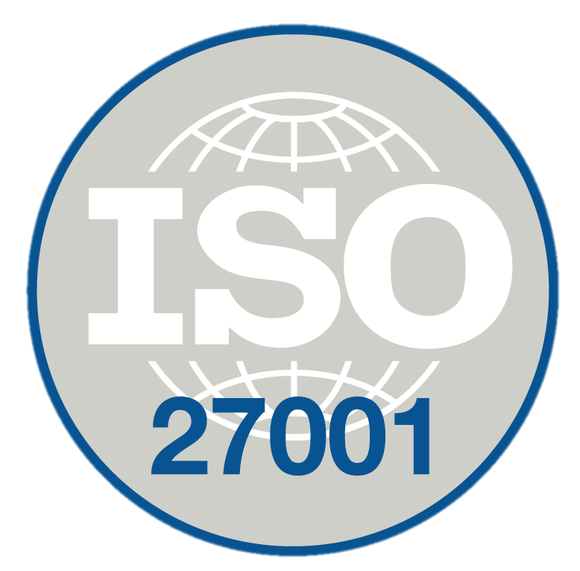
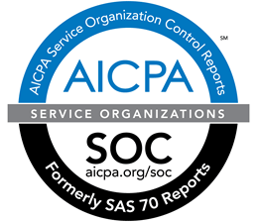
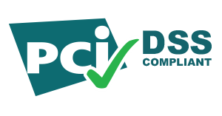
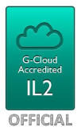
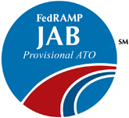

A trusted public cloud
World class compliance
Government
accredited
Leading privacy protections
EU Model Contracts
HIPAA Business Associate Agreement

Slide 39
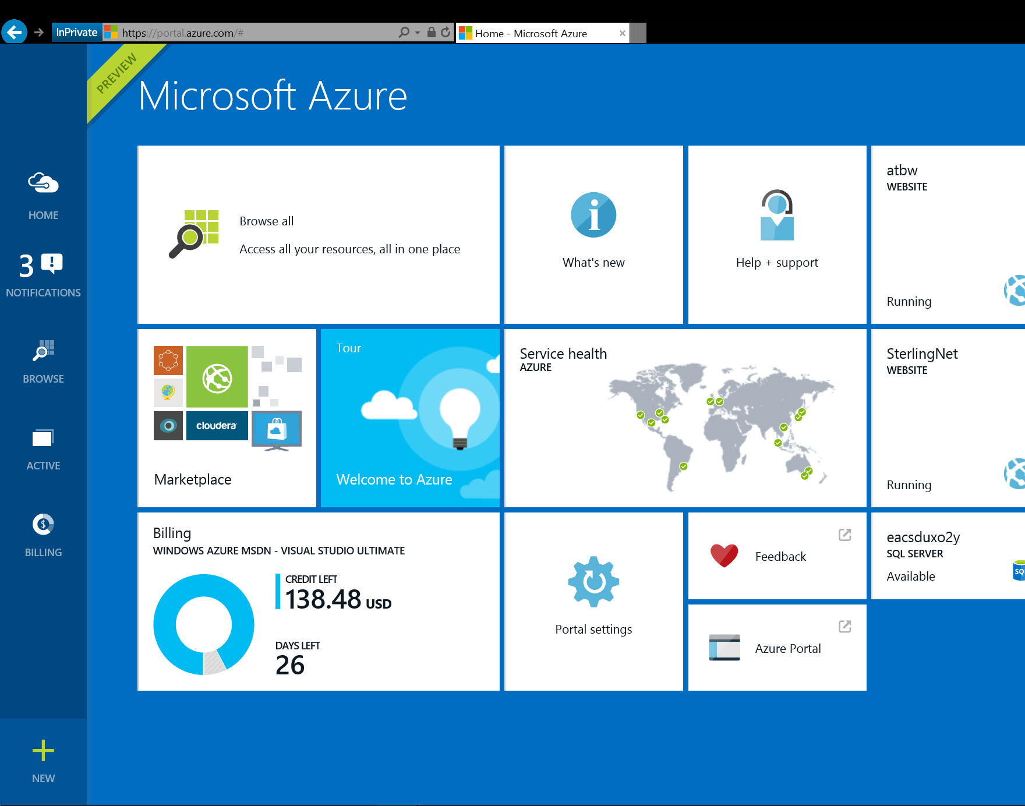

Enterprise Grade Enhancements
G
Largest VMs in Public Cloud
Premium Storage
End to End Management
Optimized for data workloads
Up to 32 CPU cores, 450 GB RAM, 6.5 TB local SSD
Latest generation Intel processor
Up to 64 TB of storage per VM
>50,000 IOPS per VM
Less than 1ms read latency
Integrated management portal
Application Templates
Lifecycle Management
Role Based Access Control
Billing API

Slide 40
New Compute Instance: D series V2 Sizes
Availability: September CY2015(GA)
What is the feature?
Standard Memory
Name | vCores (non-HT) (Intel E5-2673 v3 2.4GHz) | Memory (GB) |  | Local SSD (GB) | Networking (Mbps)
Standard_D1_v2 | 1 | 3.5 |  | 50 | 750 ~ 1000
Standard_D2_v2 | 2 | 7 |  | 100 | 1500 ~ 2000
Standard_D3_v2 | 4 | 14 |  | 200 | 3000 ~ 4000
Standard_D4_v2 | 8 | 28 |  | 400 | 6000 ~ 8000
Standard_D5_v2 | 16 | 56 |  | 800 | 12000 ~ 16000
High Memory
Standard_D11_v2 | 2 | 14 | 100 |  | 1500 ~ 2000
Standard_D12_v2 | 4 | 28 | 200 |  | 3000 ~ 4000
Standard_D13_v2 | 8 | 56 | 400 |  | 6000 ~ 8000
Standard_D14_v2 | 16 | 112 | 800 |  | 12000 ~ 16000
D Series V2 or Dv2 runs on the latest generation of server using the newer intel E5-2673 v3 2.4GHz processor. Dv2 cores on an average are 30-35% faster than DV1 core. Networking bandwidth is ~ 1.5x-2x more for Dv2 VMs
Notes:
How do stack versus competition?
This feature is unique to websites and not offered by competitors

Slide 41
Virtual Machine(VM) Scale Sets
Availability: March CY2016 (GA)
What is the feature?
Scale Sets provide an easy way to deploy and manage groups of identical VMs. They provide a solution to the problem of delivering customized and scalable VM deployments without needing to correlate independent network, storage and compute resources. Features include auto-scale, load balancing, custom and marketplace VMs (Windows/Linux).
Scale Set 1
Scale Set 2
Scale Set 3
Auto-scale | Load balancing | Custom and marketplace VMs

Slide 42
Reservations for Instance Level IP
Availability: December CY2015
What is the feature?
Customers can now associate Reserved IP Addresses to the Network Interface card of a Virtual Machine. Additionally, they can also reserve the existing dynamic Public IP Addresses on the Virtual Machine.
Reserved IPs per virtual device
10.0.0.2
10.0.0.3
191.239.213.197
VM1
VM2
VM3

Slide 43

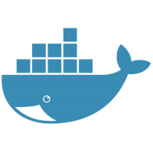

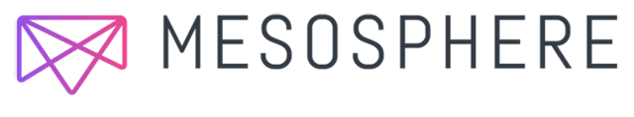

Azure Container Service
Availability: April CY20106
App 2
What is the feature?
App 1
App 3
Azure Container Service builds on our work with Docker and Mesosphere to create and manage scalable clusters of host machines onto which containerized applications can be deployed, orchestrated, and managed.
By leveraging Azure Container Service Resource Provider for Azure Resource Manager(ARM), Azure Container Service will make it easy for you to create and manage clusters of hosts pre-configured with Docker, Apache Mesos, Marathon and Docker Swarm. This work couples Azure's hyper-scale and enterprise-grade cloud with proven open source technologies to deliver the foundation for the container deployment, orchestration, and management service any team building container apps will need.
Docker Compose
Docker swarm
Marathon, Chronos
VM
VM
VM
Mesos cluster
Azure Management and Ecosystem

Slide 44
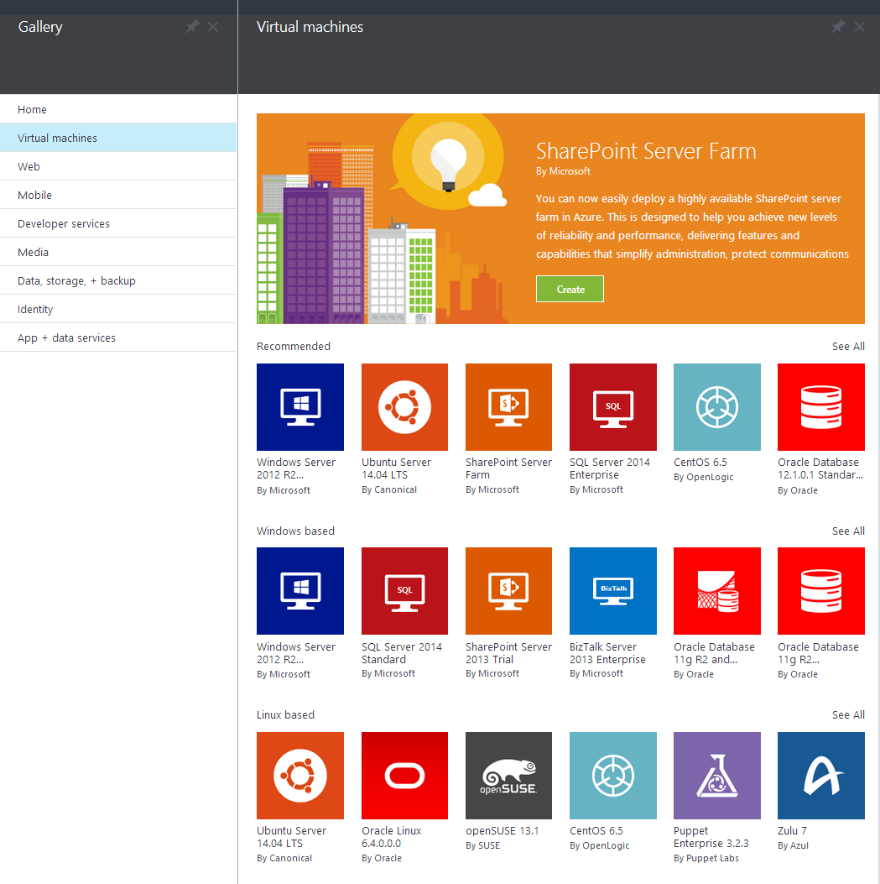
Azure Marketplace
Linux
Oracle
IBM
SAP
Informatica
Cloudera
Hortonworks
DataStax

Slide 45
We’re Reimagining Microsoft
Our Mission
Our Strategy
Build the best-in-class platforms and productivity services for the mobile-first, cloud-first world
We will empower
every person and
every organization
on the planet
to achieve more
Our Ambitions
Reinvent productivity & business processes
Build the intelligent cloud platform
Create more personal computing
Notes:
[Script]:
Every great company has an enduring mission. We’ve challenged ourselves to think about our core mission, our soul – what would be lost if we disappeared.
We will empower every person and every organization on the planet to achieve more. We have unique capabilities in harmonizing the needs of both individuals and organizations. This is in our DNA. Perhaps “on the planet” is the most important and interesting idea in that statement. We care deeply about making a difference in lives and organizations in all corners of the planet.
Our strategy is to build best-in-class platforms and productivity services for a mobile-first, cloud-first world. Our platforms will harmonize the interests of end users, developers and IT better than any competing ecosystem or platform. We will realize our mission and strategy by investing in three interconnected and bold ambitions.
Again, doing so isn’t simply good business. It’s playing a part in the most fundamental of human activities: creating tools that enable each of us to continue our journey to become something more. In summary, we want to Empower you to achieve more!

Slide 46
“This is not your Dad’s Microsoft.”

Slide 47
Our Approach to Open Source in the Cloud
Enable
Integrate
Release
Participate
Enable Linux and Open Source technology to be first class citizens on Microsoft Platforms
Embrace leading Open Source ecosystems and integrate Microsoft products with agility and consistency
Release key Microsoft technologies into the Open Source domain to build a strong ecosystem
Microsoft engineers to participate in communities and contribute to key Open Source projects
R Server
.NET Core
Roslyn
TypeScript
F#
autorest
PowerBI Visuals
Office UI Fabric
Tools plugins
Open Source Partners & Ecosystem
Notes:
Notes coming soon – please check back on http://aka.ms/opensource for latest version

Slide 48
Open Source Investments are Fueling the Momentum
Our Products
Our Offerings
Azure Marketplace
60% of all images in Azure Marketplace are based on Linux/OSS
SQL Server on Linux
Acquisition
Windows Subsystem for Linux
1 out of 3 VMs on Azure run Linux, and more than half of all new VMs run Linux
C:\Users\markhill> bash
1 out of 3
HD Insight managed service on Linux
root@localhost: #
Run Linux on Windows natively
Our Partnerships
Our Employees
Ross Gardler President Apache SW Foundation
Wim Coekaerts Oracle’s Mr. Linux joins Microsoft
Partnership
Jenkins project on Azure
Partnership with the Linux Foundation for Linux on Azure certification
600 Million+
Lines of open source code submitted to GitHub by Microsoft engineers
Microsoft joins Eclipse Foundation
Microsoft Open Source Hub
Notes:
Notes coming soon – please check back on http://aka.ms/opensource for latest version

Slide 49
Azure: Delivering Open Source Innovation in the Cloud
Addressing Your Enterprise Cloud Needs in a Trustworthy Way
Private Cloud
Hybrid Cloud
Public Cloud
Trust In Microsoft
..... Now Across Your Entire Stack!
Management
System Center
OMS
DevOps & PaaS
Team Foundation Services
Applications
Dynamics
SharePoint
Exchange
Frameworks & Tools
.NET
Visual Studio
Data
SQL Server
Infrastructure
Windows
Server
Notes:
Notes coming soon – please check back on http://aka.ms/opensource for latest version

Slide 50
PowerShell Core and Bash on Windows 10
PowerShell
Linux and OS X
Heterogeneous world
Use any client
Run workloads on any server
And any cloud
Linux
OS X
Notes:
Open source
GitHub
MIT License
Open to community development
Contributors
Committers
Refactored on .NET Core
One code base for all OSes

Slide 51




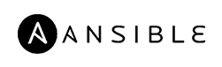



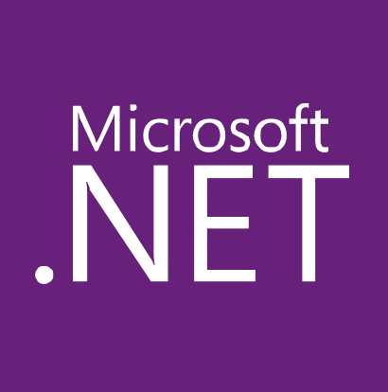


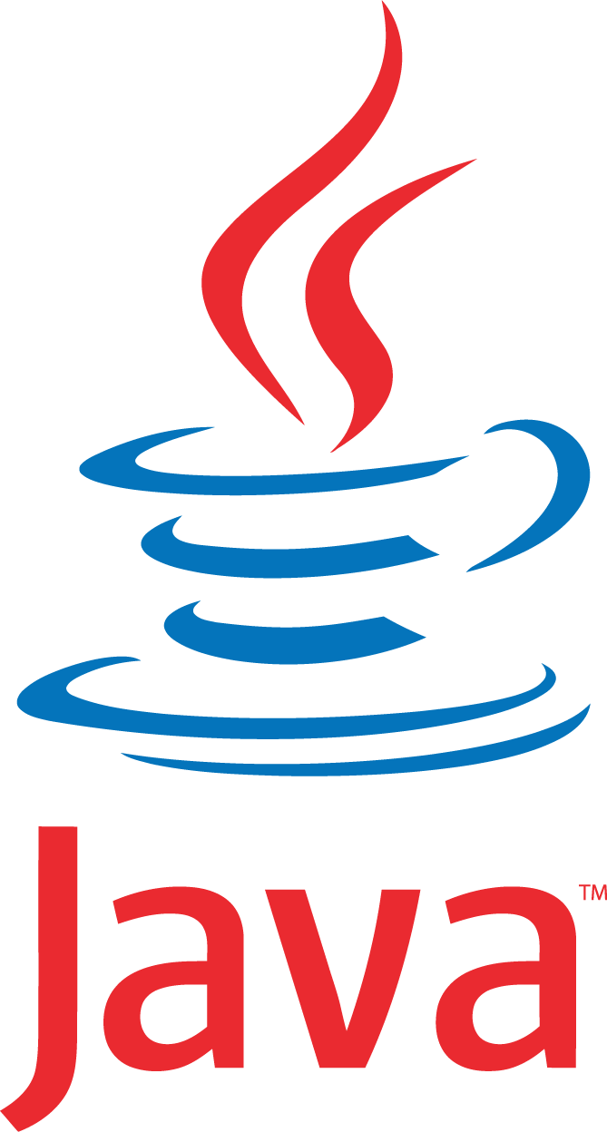



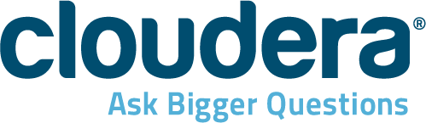

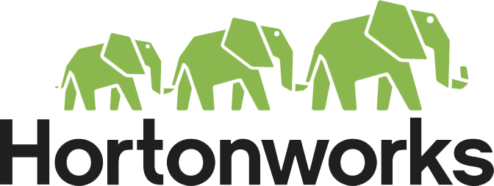










Build and run open source solutions
Any tool, application, framework
Applications
DevOps
Frameworks
Databases & middleware
Containers
Infrastructure
Notes:
We’re heavily invested in open-source technologies and partnerships, as evidenced on this slide. Nearly one in three Azure virtual machines are now running Linux, and we support Linux as a first class citizen.
Why is this important to Microsoft? Because it’s in the best interest of our customers. In fact, over 40% of CIOs are using open source as their primary strategy heading into 2017. We support our customers’ computing, whatever it is and wherever it is.
Finally, we contribute to the open source community as well as build some of our services on open source technology, like HDInsight and Azure Container Service. This also helps us scale to our customers’ needs as we rapidly release cloud solutions.

Slide 52
Microsoft Operation Management Suite (OMS) Multi-cloud IT management
Windows
Server
(VM)
Windows
Server
(VM)
Windows
Server
(VM)
Windows
Server
(VM)
Linux
(VM)
Microsoft Operation Management Suite
Windows
Server
(VM)
Windows
Server
(VM)
Linux
(VM)
Linux
(VM)
Linux
(VM)
Azure
Amazon Web Services
Log Analytics
Automation
Backup, DR and Data Protection
Security
Windows
Server
(Guest)
Windows
Server
(Guest)
Windows
Server
(Guest)
Windows
Server
(Guest)
Linux
(Guest)
Private Clouds (HyperV, VMWare, OpenStack)

Slide 53


Slide 54
Extend on-premises data and apps
Hybrid Use Cases
Seamless & secure across:
Application Availability
Bottomless Storage
Identity Management
Full hybrid applications
INFRASTRUCTURE
Azure Backup
Azure Site Recovery
DATA
Azure StorSimple
SQL Server Stretch DB
USERS
Azure Active Directory
APPS
App Service
Web | Mobile | Logic Apps | API Apps
MANAGEMENT
Operations Management Suite
Notes:
With Azure, you can take the investments you’ve made in data and intellectual property, and extend from on-premises to the cloud, or vice versa. Azure provides the portability to move your technology investments, whether open source or not, from cloud to on-premises and vice versa.
Companies fall into two main buckets with regards to hybrid: those who are using hybrid solutions as a temporary bridge to the cloud, and companies who are architecting hybrid solutions for use in perpetuity.
Amongst each of these types of customers, there are common use cases such as:
Application Availability
Bottomless Storage
Identity Management
Full hybrid applications
We provide seamless, secure hybrid cloud capabilities across infrastructure, data, users, apps, and management.

Slide 55
Connect every on-premises server to the cloud
Azure
Storage
Backup
Disaster recovery
Identity
Networking
On-Premises Datacenter

Slide 56

Azure Site Recovery (VMware to Azure)
Availability: July CY2015 (GA)
What is the feature?
Azure Site Recovery functionality protects VMware VMs and physical servers using Azure as a disaster recovery site. Site Recovery provides near-zero recovery point objective (RPO) with continuous data-protection technology. Customizable Site Recovery plans can ensure that multi-tier applications are recovered to a consistent point in time, minimizing lost transactions and application errors. When primary data center recovers, customers can almost seamlessly failback to on-premises virtual infrastructure. It also enables testing new versions of applications and then failback a new version into production in customers’ data center—or continue to run applications in Azure as part of migration to the cloud.
Extensive capacity and scalability for: site recovery | dev/test | cloud burst
VMware VMs
Physical
Servers
VM2
VM1
VM3

Slide 57











ExpressRoute
Availability: September CY2015 (GA)
ExpressRoute Partners
ExpressRoute
What is the feature?
With Microsoft Azure ExpressRoute, you can create private, high-throughput connections between Azure datacenters and your existing infrastructure, whether it’s on-premises or in a co-location environment, enabling and simplifying hybrid environments. ExpressRoute connections do not go over the public Internet, and they offer more reliability, faster speeds, lower latencies and higher security than typical connections over the Internet.
Customers enjoy a 99.9 percent SLA on ExpressRoute connection uptime, dual redundant circuits and multi-region connectivity within a geo. Plus, they have two new bandwidth tiers for the Exchange Provider scenario: 200 Mbps and 500 Mbps
Pricing or other details
Please see http://www.windowsazure.com/en-us/pricing/details/expressroute/ .
Currently AT&T and Equinix customers are able to use the ExpressRoute service at Silicon Valley, Washington, and London ExpressRoute locations
Documentation
Microsoft Azure
Microsoft Azure
Public Internet
Public Internet
WAN
ExpressRoute location
Multiple customer sites
Customer site
Connecting at ExpressRoute Location (Exchange Provider facility)
Connecting from a WAN (e.g. MPLS VPN) provided by network services providers
Notes:
Competition
AWS has DirectConnect that allows the same. Our differentiation with respect to AWS is that
a) Our partnerships with global telcos allows customers to add Azure directly to their existing MPLS WANs and
b) ExpressRoute connections have inbuilt redundancy (2 circuits get provisioned per connection).

Slide 58
ExpressRoute for Office 365
Availability: September CY2015 (GA)
What is the feature?
Microsoft Datacenter
Office 365
Services on ExpressRoute
ExpressRoute for Office 365 enables access to Office 365 using ExpressRoute. It provides O365 customers an alternative to the public Internet connection by providing premium network connection to Microsoft datacenters.
ExpressRoute provides dual connections per circuit for high availability and an uptime SLA of 99.9%.
Customer Site 2
Office 365
Services Require
Internet
EXPRESSROUTE
Azure services
Internet Co-lo
Customer
Datacenter
Public internet
Alternate connection

Slide 59
Deploy the cloud on-premises
Azure Stack
Portal | PowerShell | Dev-ops tools
Portal | PowerShell | Dev-ops tools
One Azure ecosystem
Azure Resource Manager
Azure Resource Manager
Unified app development
Azure IaaS | Azure PaaS
Azure IaaS | Azure PaaS
Compute | Networking | Storage
App Service | Service Fabric
Azure services in your datacenter
Cloud infrastructure
Cloud-inspired infrastructure
Microsoft Azure
PUBLIC
Microsoft Azure Stack
PRIVATE | HOSTED
Notes:
Azure Stack provides the capabilities of Azure for customers who want to host it on their own premises. The Azure portal acts as a hub for managing between cloud and on-premises.
On the left hand side, you have Microsoft Azure as a public cloud offering. Note that on the right, with Azure stack, the parity between key elements:
Portal | PowerShell | Dev-ops tools provide the same end user experiences and same app model.
Azure Resource Manager lets you build reusable application templates for traditional and cloud-native apps.
Azure IaaS and PaaS services are available in both for unified app dev.
On the infrastructure layer, we are making some translation – Azure runs on hyper-scale (each scale unit is 20 racks!) while you folks likely run a lesser footprint. So we’re doing some work to make this fit into your environments.
This provides some key benefits across roles:
Application developers can maximize their productivity using a ‘write once, deploy to Azure or Azure Stack’ approach. Using APIs that are identical to Microsoft Azure, they can create applications based on open source or .NET technology that can easily run on-premises or in the public cloud. They can also leverage the rich Azure ecosystem to jumpstart their Azure Stack development efforts.
IT professionals can help transform on-premises datacenter resources into Azure-consistent IaaS and PaaS services, thereby maximizing agility and efficiency. End users can quickly provision services using the same self-service experience as Azure. IT gets to use the same automation tools as Azure to control the service delivery experience.
Business leaders can truly take advantage of cloud on your terms.

Slide 60
Azure Stack
Private cloud infrastructure consistent w/ Azure
IaaS, Storage, App Service, Service Fabric, SQL
Software Defined Storage and Networking
Optional Certified Hardware Systems

Slide 61
Microsoft Cloud
Secure Productive Enterprise &
Operations Management Suite
Cortana Intelligence Suite
Office 365
Dynamics
Azure
PRODUCTIVITY
BUSINESS APPS
SECURITY & MANAGEMENT
DATA & INTELLIGENCE
APPLICATION INNOVATION
Collaboration
Customer Service
Identity
Data Visualization
Web and Mobile
Creation
Field Service
Device
Big Data
Internet of Things
Mobile
Sales Automation
Apps and Data
Machine Learning
Data Management
Business Insights
Operations
Infrastructure
Cognitive Intelligence
Microservices
Notes:
Finally, Azure is just one component of the Microsoft Cloud. We’ve discussed integration across data and intelligence and security and management, but you also benefit from integrated solutions across productivity with Office 365, and business apps with Dynamics.

Slide 62
What Next?
Visit www.ITProCloudEssentials.com
Free Azure Credits
Skills Assessments and Training Paths for the Cloud
Learn more about DevOps
DevOps Factory - https://www.thedevopsfactory.com/
DevOps Dimensions on Ch9 – https://channel9.msdn.com/Shows/DevOps-Dimension

Slide 63
Thank you
Notes:
We’ve gone through a journey today, through the various capabilities of Azure that support your path toward digital transformation, from app innovation, to data and intelligence, to open and flexible deployments, to trust. We’re here to partner with you as you continue to innovate and transform. Thank you.

Slide 64
Extra

Slide 65
Containers A new approach to build, ship, deploy, and instantiate applications
Applications traditionally built and deployed onto physical systems with 1:1 relationship
New applications often required new physical systems for isolation of resources
Package and run apps within
containers
Physical
Physical/virtual
Higher consolidation ratios and better utilization
Faster app deployment than in a traditional, physical environment
Apps deployed into VMs with high compatibility success
Apps benefited from key VM features i.e., live migration, HA
Key benefits
Further accelerate of app deployment
Reduce effort to deploy apps
Streamline development and testing
Lower costs associated with app deployment
Increase server consolidation
Virtual

Slide 66
Containers Isolated runtime environment for hosted applications
Container
Dependencies
Every application has its own dependencies which includes both software (services, libraries) and hardware (CPU, memory, storage)
Virtualization
Container engine is a light weight virtualization mechanism which isolates these dependencies per each application by packaging them into virtual containers
Shared host OS
Container runs as an isolated process in user space on the host OS, sharing the kernel with other containers
Flexible
Differences in underlying OS and infrastructure are abstracted away, streamlining “deploy anywhere” approach
Fast
Containers can be created almost instantly, enabling rapid scale-up and scale-down in response to changes in demand
App A Bins/libraries
App B Bins/libraries
Container management stack
Host OS with container support
Server

Slide 67
Containers How do they differ from virtual machines?
Virtual machine
Dependencies
Each virtualized app includes the app itself, required binaries and libraries and a guest OS, which may consist of multiple GB of data
Independent OS
Each VM can have a different OS from other VMs, along with a different OS to the host itself
Flexible
VMs can be migrated to other hosts to balance resource usage and for host maintenance, without downtime
Secure
High levels of resource and security isolation for key virtualized workloads
App A Bins/Libraries
App B Bins/Libraries
Guest OS
Guest OS
Hypervisor
Server

Slide 68
Container use cases
Workload characteristics
Scale out
Distributed
State separated
Rapid (re)start
Deployment characteristics
Efficient hosting
Multitenancy
Rapid deployment
Highly automatable
Rapid scaling
Distributed compute
Databases
Web
Tasks
Scale out
$$f\left(x\right)$$

Slide 69
Why containers? Applications are fueling innovation in today’s cloud-mobile world
Developers
Containers unlock ultimate productivity and freedom
Enable ‘write-once, run-anywhere’ apps
Can be deployed as multi-tier distributed apps in IaaS/PaaS models
Containers offers powerful abstraction for microservices
DevOps
Integrate people, process, and tools for an optimized app development process
Operations focus on standardized infrastructure
Developers focus on building, deploying, and testing apps
Operations
Enhances familiar IT deployment models
Provide standardized environments for development, QA, and production teams
Abstract differences in OS distributions and underlying infrastructure
Higher utilization and compute density
Rapid scale-up and scale-down in response to changing business needs

Slide 70

Container OS environments
Nano Server
Server Core
Highly optimized
Highly compatible
“Born in the cloud” applications
Traditional applications

Slide 71
Container runtime
Windows Server
container(s)
Host Operating System

Slide 72

Container runtime
Windows Server container(s)
Hyper-V container(s)
Host Operating System
Virtual machine(s)
Hyper-V Hypervisor

Slide 73
Container runtime
Windows Server container(s)
Hyper-V container(s)
Hyper-V Hypervisor
Host Operating System
Virtual machine(s)
Hyper-V Hypervisor

Slide 74














More Ecosystem Building Blocks
Test
Deploy
Environments
Monitor and Learn
BIZ
Production
DEV
Chef
Puppet Labs
OPS
Gradle
Grunt
Configuration
Zabbix
Pre-Production
Develop
Jenkins
Hudson
Build
Integration
Gradle
Grunt
Developer Workstations
Jenkins
Hudson
Vagrant
GitHub
Codeplex
Dev/Test
Grunt
Gradle
Processes
Redmine
JIRA
Notes:
Microsoft solutions integrate well with other ecosystem tools. There are opensource and enterprise testing, deployment and configuration management solutions which integrate things like Powershell and Desired State Configuration, etc.

Slide 75
Security impact – In the News…
Experts: “Sony hackers were inside the company network for a long time”
“Staples breach may have affected over a million credit cards”
“Target cyber breach hits 40 million payment cards at holiday peak”
“Now at the Sands Casino: An Iranian hacker in every server”
“A cyberattack has caused confirmed physical damage for the second time ever”
“Five out of every six large companies targeted by cyber attacks in 2014”
“Home Depot confirms cyber attack from foreign entity”

